Slide 1
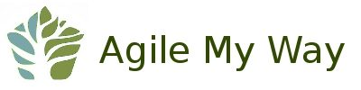
Agile at Work
event
Sponsored by
Based on requests for more Agile events, David Sietz, software architect and former educator, will be offering a hands-on workshop entitled Agile at Work.
This is session will provide practical experience of the popular Scrum framework as applied to the general work environment.
Join us as we focus on partnering with customers, identifying value, ensuring delivery, and experiencing “a day in the life” of an Agile team.
Seats are limited to 9 participants, so register early and secure your seat.
register online
www.agilemyway.org/event-agile-at-work
Durham Public Library
May 17th 2018
6:00 pm - 7:30 pm

